Slide 1
H²ORAM: Low Response Latency Optimized ORAM for Hybrid Memory Systems
Wenpeng He, Fang Wang, Dan Feng
School of Computer Science and Technology, Wuhan National Laboratory for Optoelectronics Huazhong University of Science and Technology
ICCD 2020

Slide 2
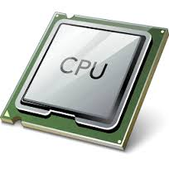
Secure Memory¹
Cloud
User
Encrypted Data
Adversary
Snoop
Trusted
Memory Bus
Untrusted
Untrusted

Slide 3
Secure Memory¹
✓ Data is safe!
Cloud
User
Encrypted Data
Oblivious-RAM (ORAM) is a mechanism for protecting memory access patterns
Adversary
Snoop
Trusted
Memory Bus
Untrusted
Untrusted
✘ Memory access pattern can leak!

Slide 4
Path ORAM ⁹
Data blocks stored in a full binary tree
Each node is a bucket that can contain several blocks
There is one path from root to each leaf node
Each data block is randomly mapped to a path
Tree contains both real and dummy blocks
A fraction of tree is always dummy
Real Block
Dummy Block
Bucket
A
Path 0

Slide 5
Path ORAM Access ⁹
Access “A”
requires
2 path accesses
A
Position Map
Block A → Path 0

Slide 6
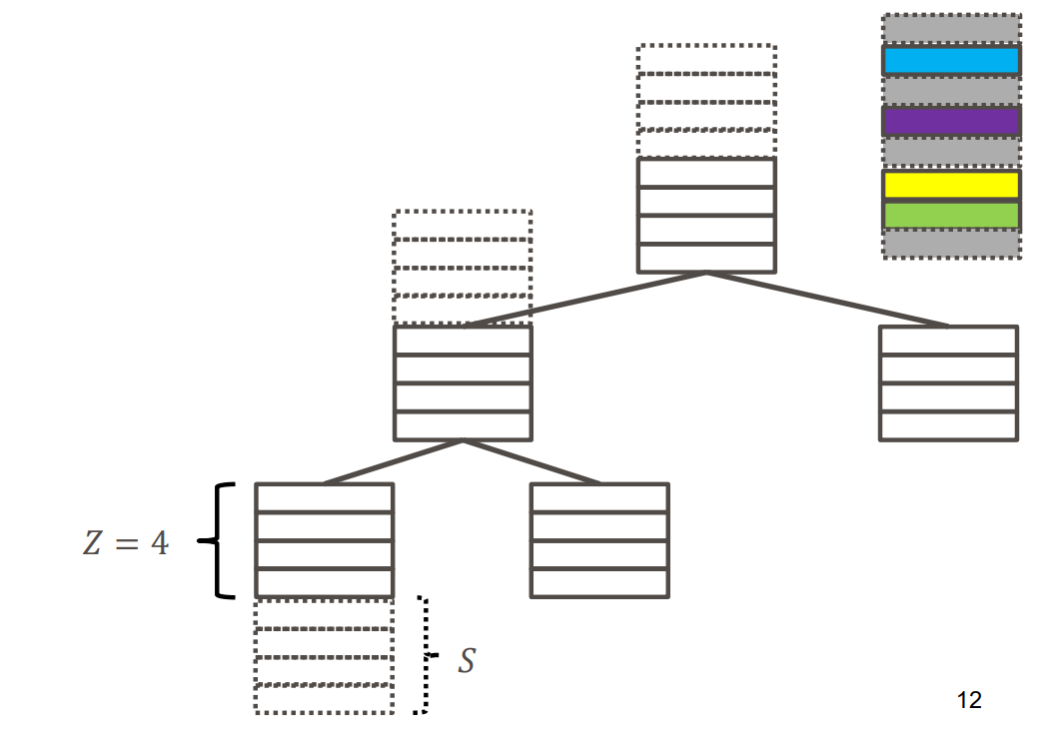
Ring ORAM
Read Path
Add S reserved dummy slots, permute buckets
Read Path reads only 1 block per bucket
One block of interest + dummy from other buckets
To do so, it keeps metadata of blocks at each bucket and prior to each Read Path it reads the metadata to know exact location of real and dummy blocks in each bucket
Early Reshuffle
Reshuffle and rewrite each bucket that is accessed S times
Evict Path
After each A (e.g. 5) accesses, it reads and writes an entire path to reduce stash occupancy
This operation is similar to a regular access in Path ORAM

Slide 7
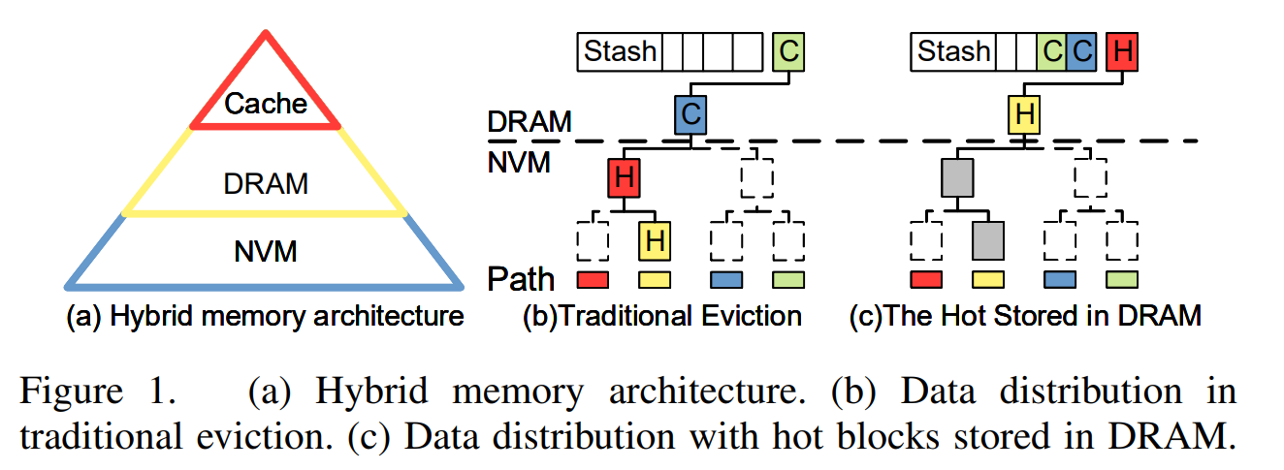
ORAM in Hybrid Memory

Slide 8
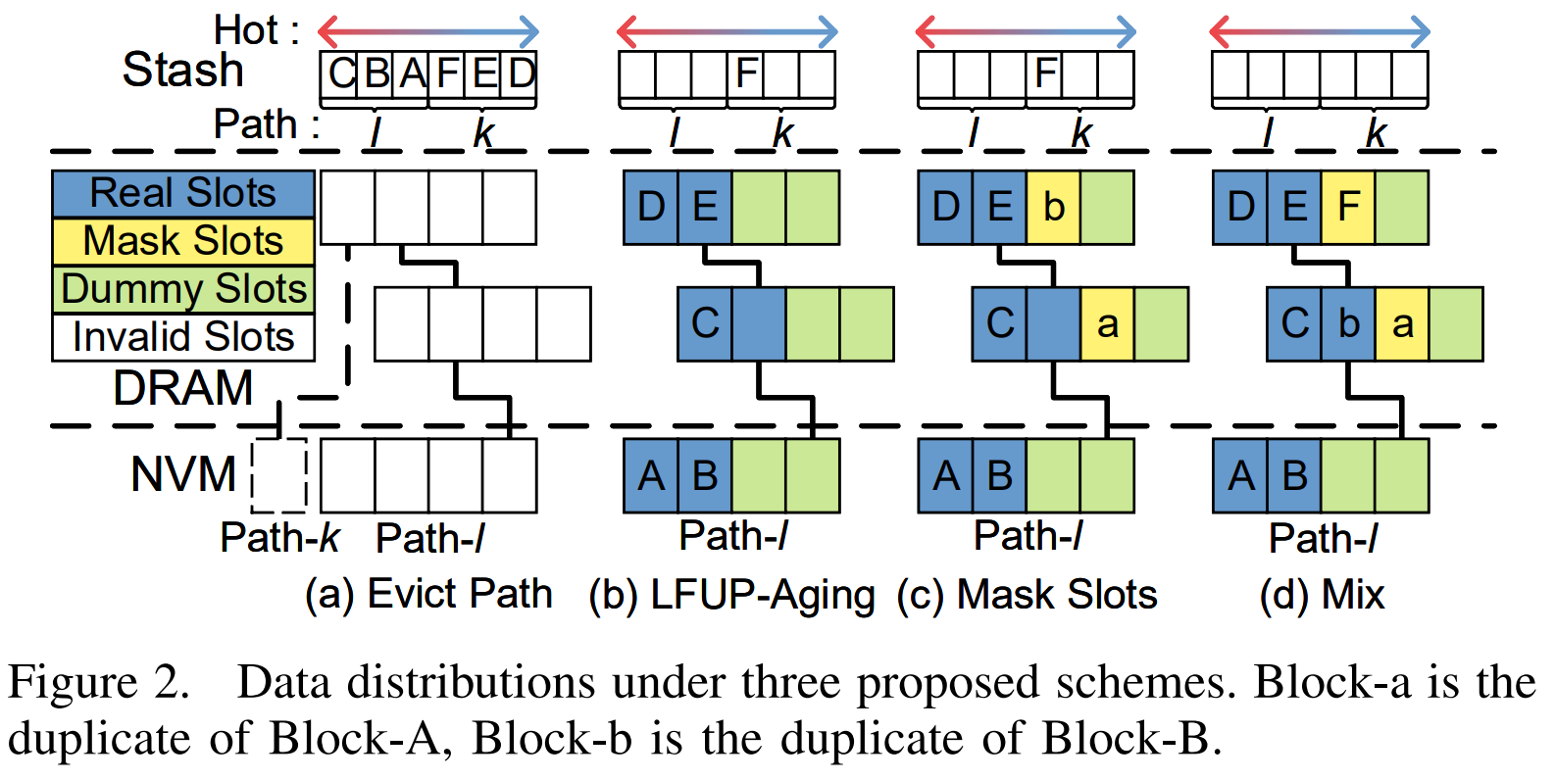
H²ORAM Optimization
LFUP-Aging
least frequently used blocks are preferred for eviction
Mask Slots
Duplicate leaves into DRAM dummies
Mix
dynamically adjust the number of real/duplicate blocks

Slide 9
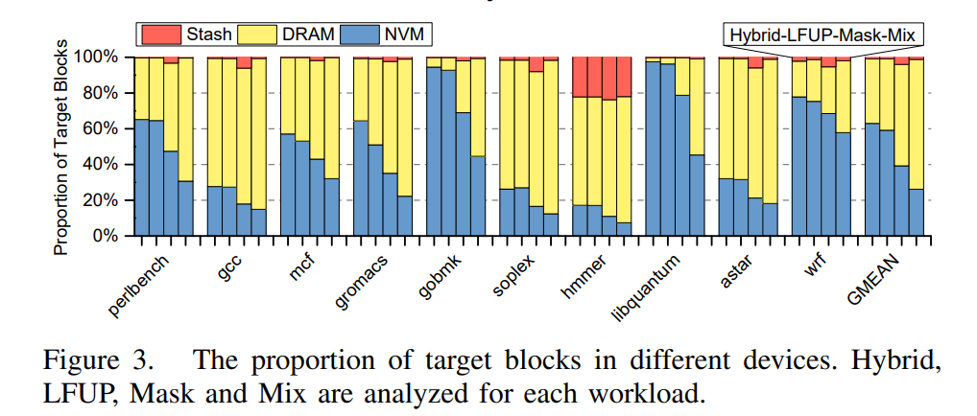
Results
The DRAM hit ratio is increased from 36% in the Hybrid to 72% in the Mix

Slide 10
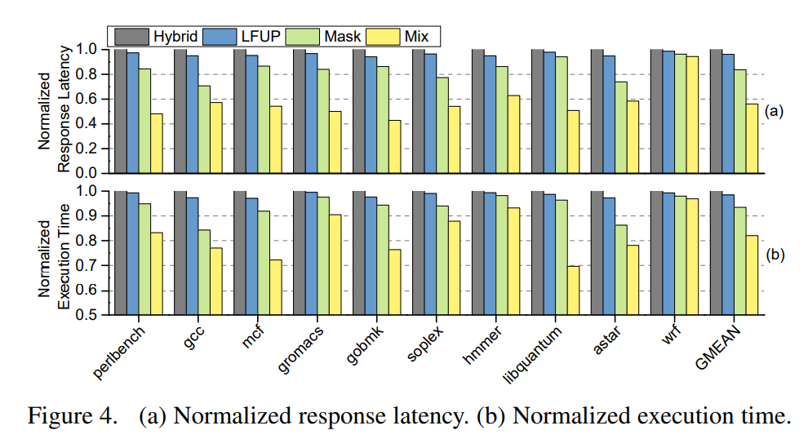
Results
Response Latency Reduction
LFUP 4%
Mask 16%
Mix 44%
Overall Exe time Reduction
LFUP 2%
Mask 7%
Mix 18%

